Slide 1

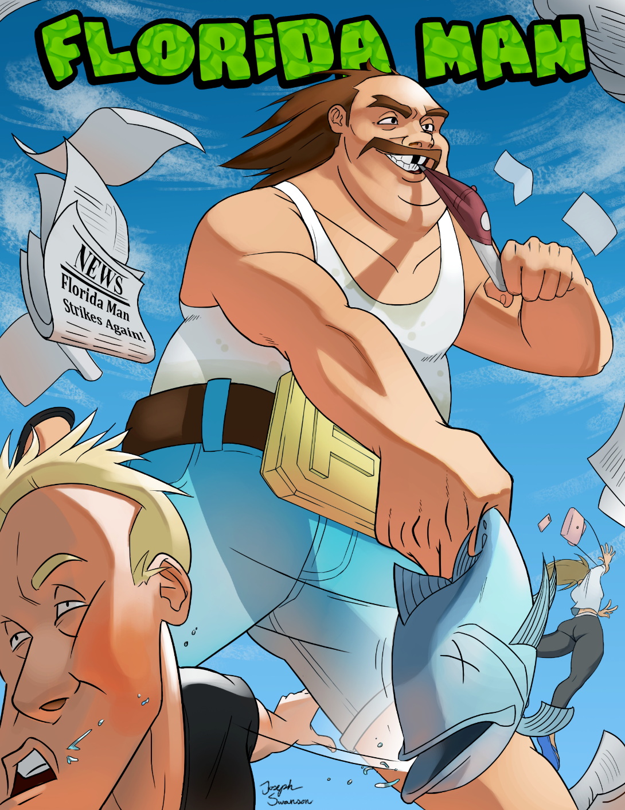
Joe Swanson – Lead Designer, Art Director
Gus Dubetz – Project Manager, Level Designer
Jesse Plaetz – 3D Artist, UI Artist
Austin Krieger – Programmer
Gabe Landwehr – Programmer
Quinton Halliday – Level Designer, Narrative, Utility
Dillon Johnson – Level Designer, Narrative, Utility

Slide 2
Core Experience
Explore a suburban town through the twisted perception of Florida Man, causing discomfort and mayhem along the way in an effort to gain infamy through wacky newspaper headlines.

Slide 3

Gameplay

Slide 4
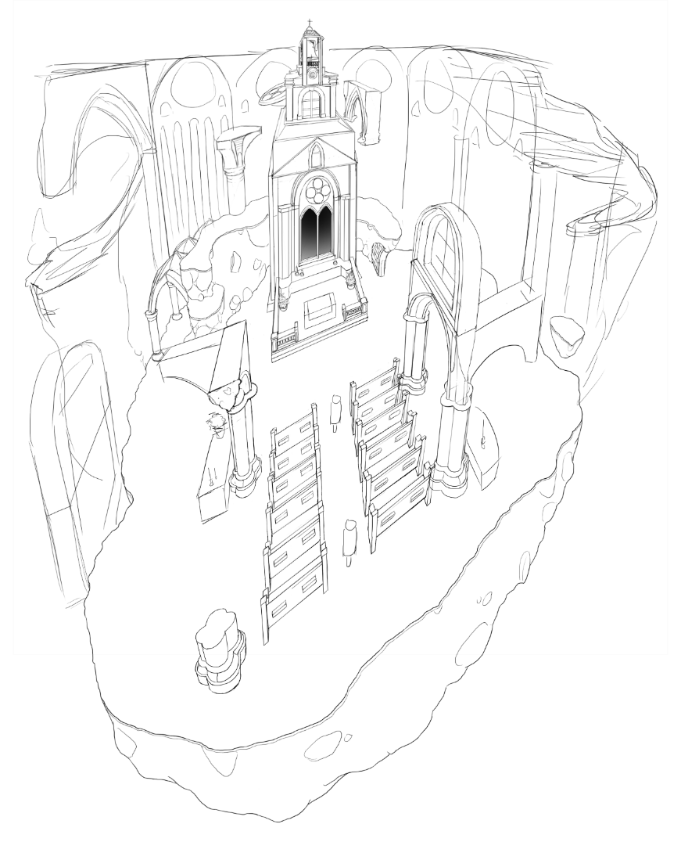
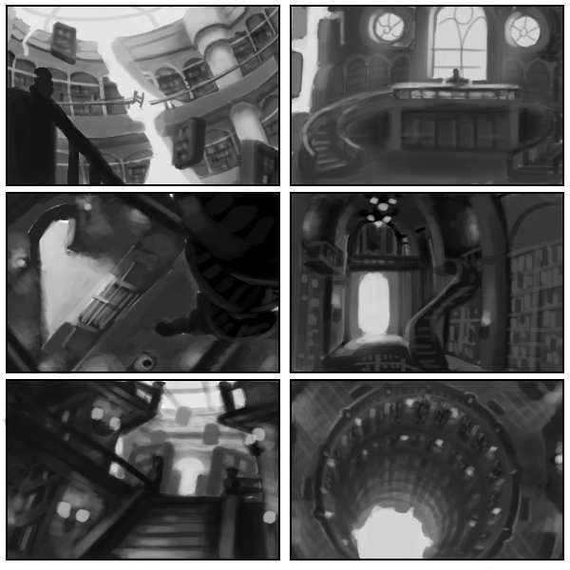
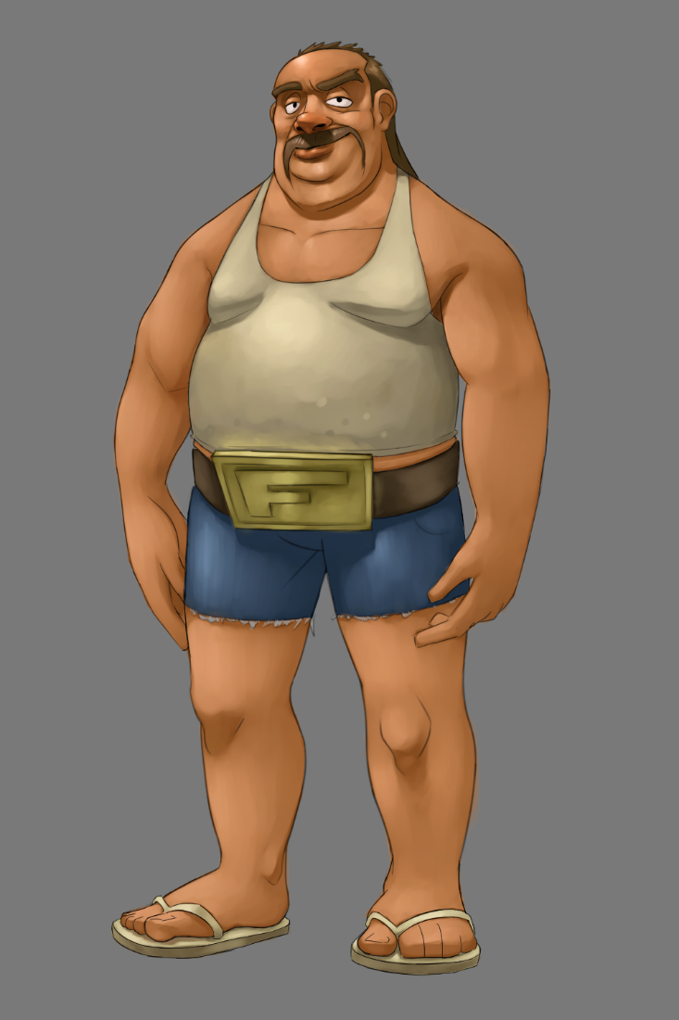
Process & Progress

Slide 5
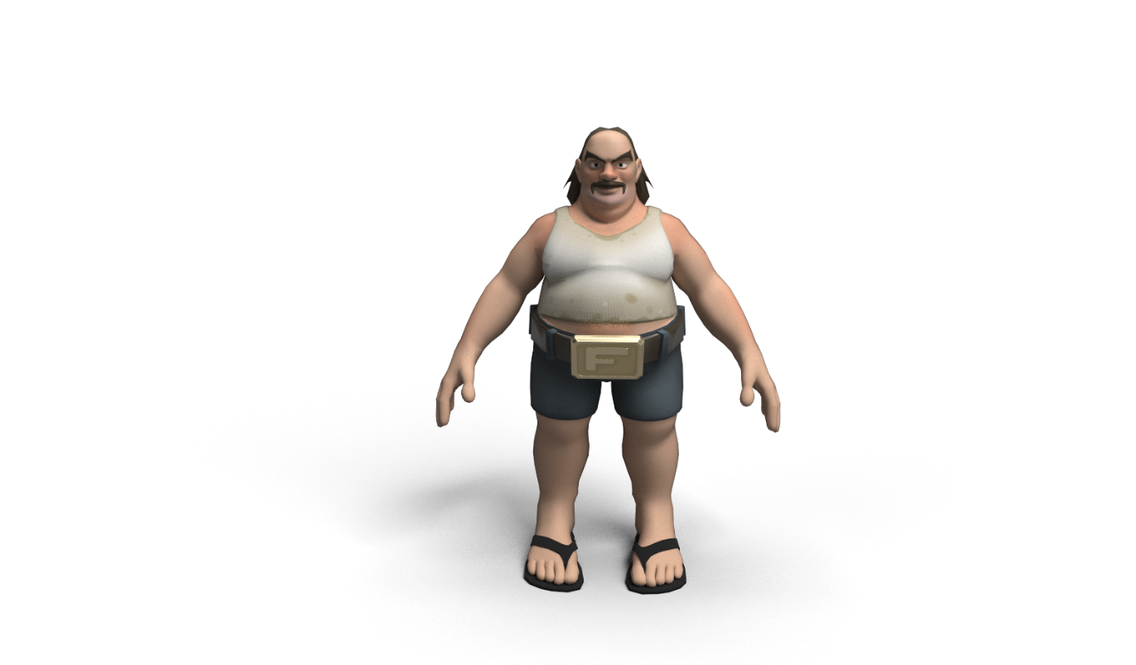
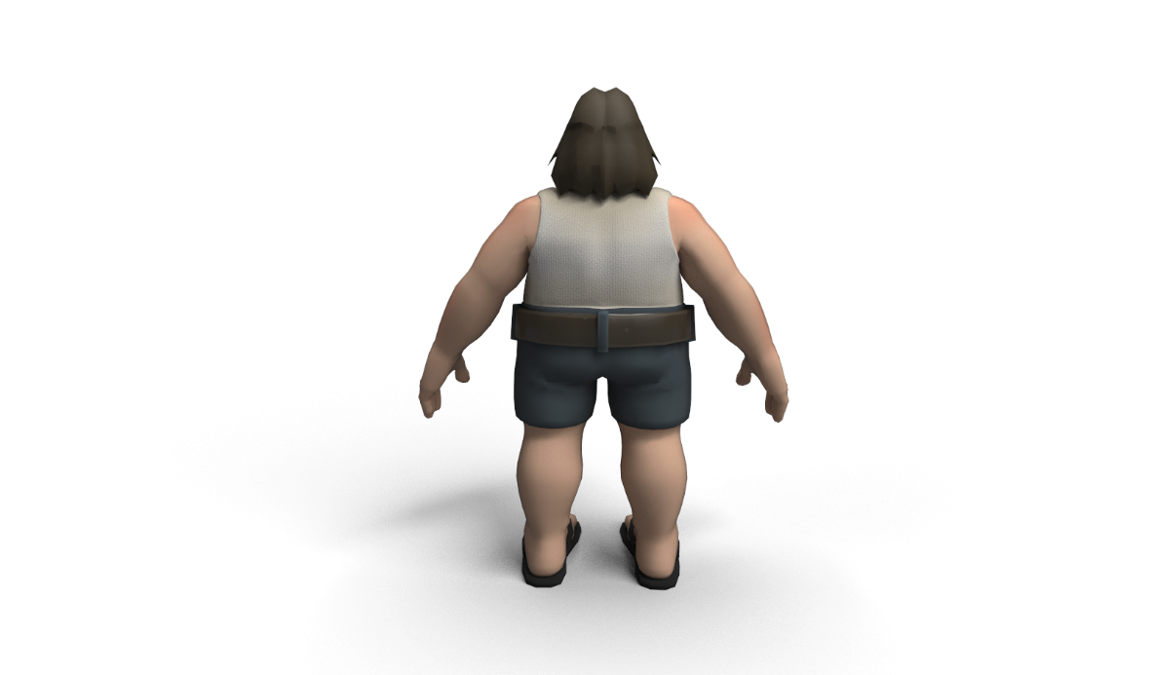
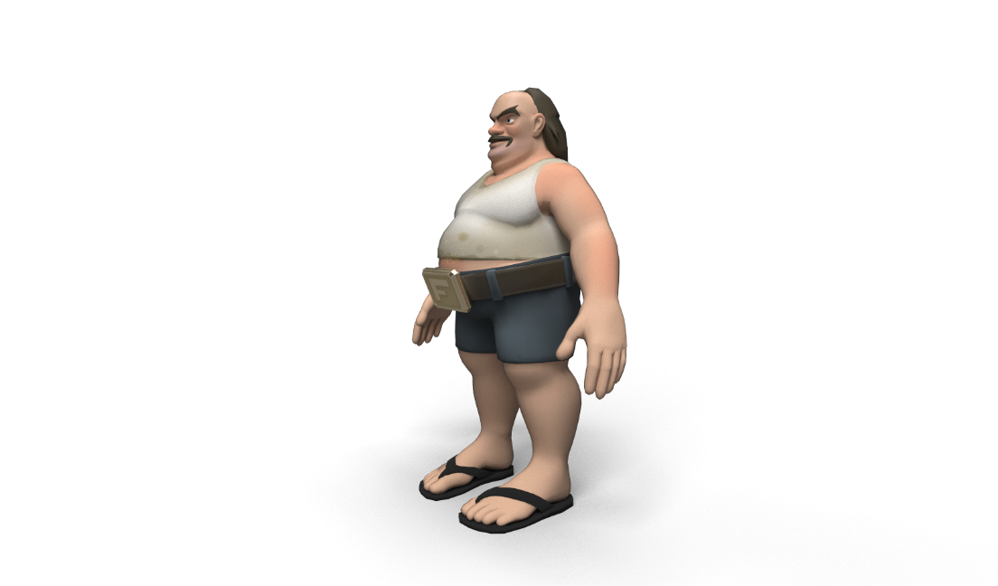
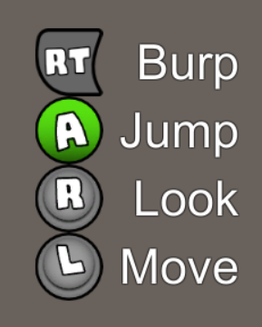

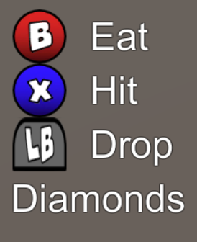
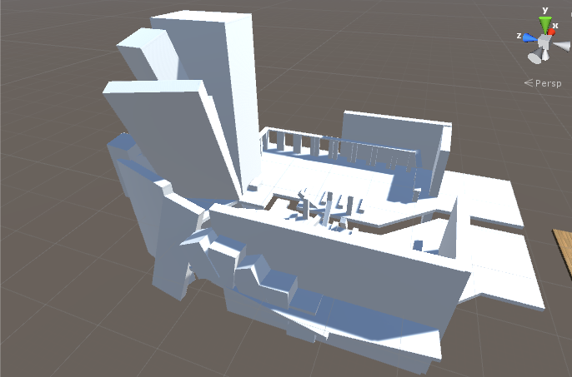
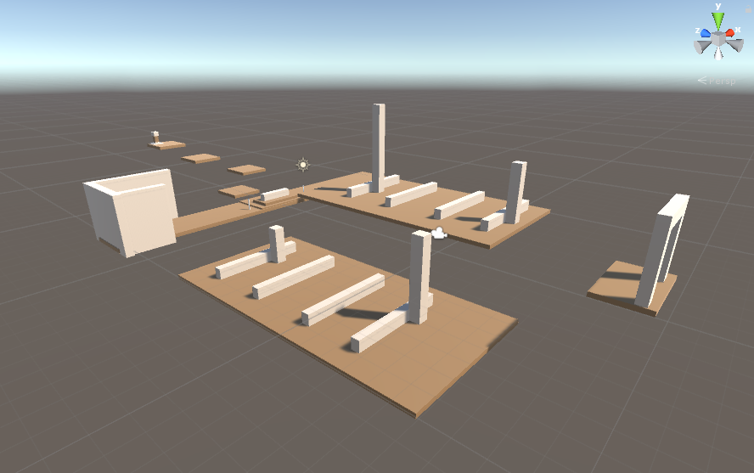
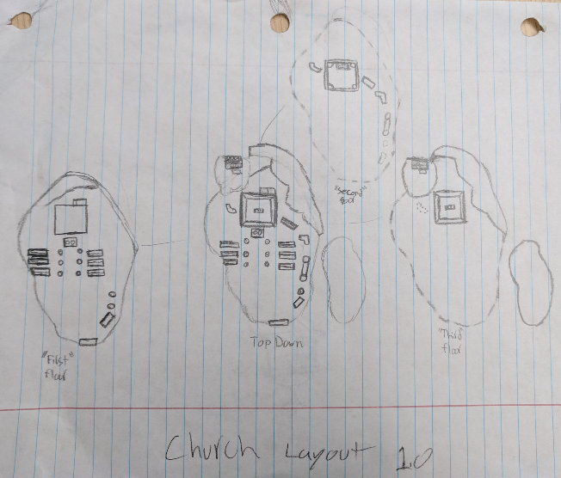
Process & Progress

Slide 6
What We Learned
Dictionaries > if statements (Gabe)
Movement & Camera – iterations (Austin)
White-blocking is limiting (Quinton)
Organizing work into achievable tasks (Joe)
Design iterations take time (Dillon)
Not to focus all your energy on early iterations (Jesse)
Playtesting feedback revealed player motivations (Gus)

Slide 7
Future Plans
Special items that grant new abilities
White-blocking the next iteration of levels
Environmental 3D models
Add more headlines
More sounds/music (including voice acting)
NPCs
Iterate on movement and camera
Iterate on UI design

Slide 8
Questions?

